Slide 1

Web Application Development
COMP-229
Fall 2023

Slide 2
Introducing npm

Slide 3
Introducing npm
Node.js is a platform, which means its features and APIs are kept to a minimum.
To achieve more complex functionality, it uses a module system that allows you to extend the platform.
The best way to install, update, and remove Node.js modules is using npm.
npm is mainly used as:
A registry of packages for browsing, downloading, and installing third-party modules
A CLI tool to manage local and global packages
NPM is installed during the Node.js installation process

Slide 4
Using NPM
NPM has two installation modes: local and global.
The default local mode is used more often and installs the third-party packages in a local node_modules folder placed inside your application folder.
It has no effect system-wise, and is used to install the packages your application needs, without polluting your system with unnecessary global files.
The global mode is used to install packages you want Node.js to use globally.
Will demonstrate the use of NPM by installing Express

Slide 5
Using NPM
The global mode will usually install the packages in the C:\Users\%USERNAME%\AppData\Roaming\npm\node_modules folder, making it available to any Node.js application running on the system.
To install a package using the npm run the following command:
$ npm install <Package Unique Name>
Installing a module globally is similar to its local counterpart, but you'll have to add the –g flag as follows:
$ npm install –g <Package Unique Name>

Slide 6
Using NPM
For example, to locally install Express, you'll need to navigate to your application folder and issue the following command:
$ npm install express
NPM supports a wide range of semantic versioning, so to install a specific version of a package, you can use the npm install command as follows:
$ npm install <Package Unique Name>@<Package Version>
For instance, to install the second major version of the Express package, you'll need to issue the following command:
$ npm install express@2.x

Slide 7
Using NPM
Removing a package using NPM
To remove an installed package, you'll have to navigate to your application folder and run the following command:
$ npm uninstall < Package Unique Name>
NPM will then look for the package and try to remove it from the local node_modules folder.
To remove a global package, you'll need to use the -g flag as follows:
$ npm uninstall –g < Package Unique Name>

Slide 8
Using NPM
Updating a package using NPM
To update a package to its latest version, issue the following command:
$ npm update < Package Unique Name>
NPM will download and install the latest version of this package even if it doesn't exist yet.
To update a global package, use the following command:
$ npm update –g < Package Unique Name>

Slide 9
Managing dependencies using the package.json file
NPM allows you to use a configuration file named package.json in the root folder of your application.
In your package.json file, you'll be able to define various metadata properties of your application, including properties such as the name, version, and author of your application.
This is also where you define your application dependencies.

Slide 10
Managing dependencies using the package.json file
The package.json file is basically a JSON file that contains the different attributes you'll need to describe your application properties.
An application using the latest Express packages will have a package. json file as follows:
{
"name" : "MEAN",
"version" : "0.0.1",
"dependencies" : {
"express" : "latest“
}
}

Slide 11
Creating a package.json file
While you can manually create a package.json file, an easier approach would be to use the npm init command.
To do so, use your command-line tool and issue the following command:
$ npm init
NPM will ask you a few questions about your application and will automatically create a new package.json file for you.
A sample process should look similar to the following screenshot:

Slide 12
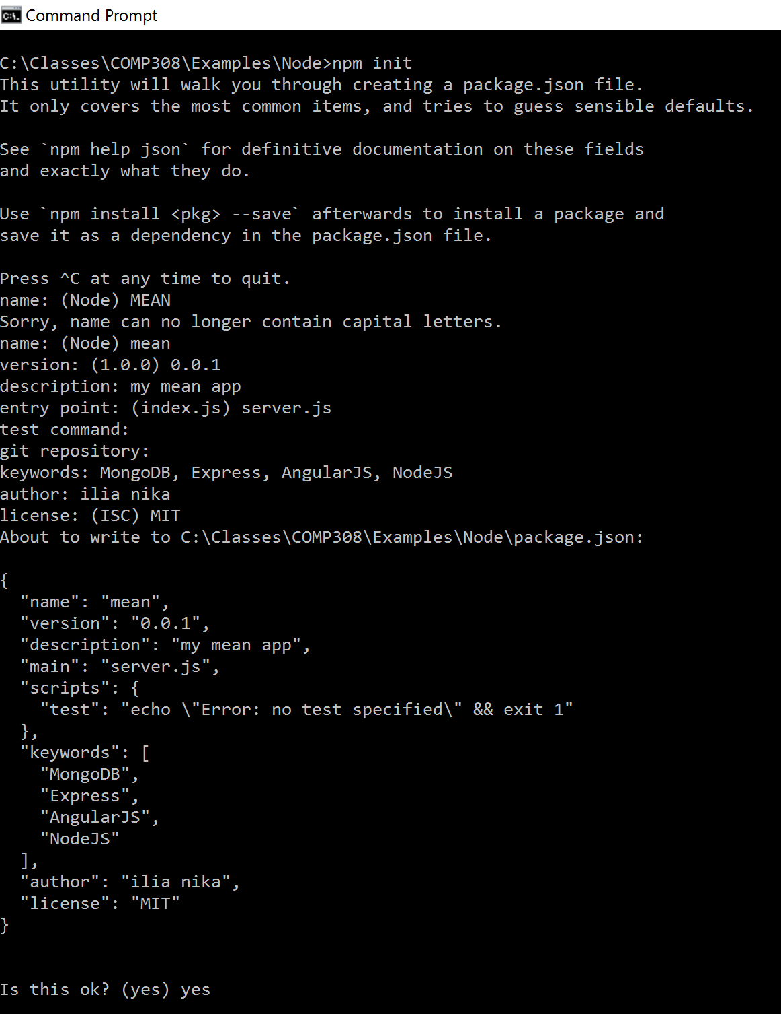
Creating a package.json file

Slide 13
Installing the package.json dependencies
After creating your package.json file, you'll be able to install your application dependencies by navigating to your application's root folder and using the npm install command as follows:
$ npm install
NPM will automatically detect your package.json file and will install all your application dependencies, placing them under a local node_modules folder.
An alternative and sometimes better approach to install your dependencies is to use the following npm update command:
$ npm update

Slide 14
Updating the package.json file
Another robust feature of the npm install command is the ability to install a new package and save the package information as a dependency in your package.json file.
This can be accomplished using the --save optional flag when installing a specific package.
For example, to install the latest version of Express and save it as a dependency, you can issue the following command:
$ npm install express --save

